Slide 1
Student Catalog
Mănică Mihai
https://github.com/ManicaMihai/StudentCatalog

Slide 2
This application targets schools and universities, offering a simple and live view of the grades for the pupils/students and an easy to use interface for teachers to add, update and delete grades and also delete students accounts and view user students account details(without their passwords, of course).

Slide 3
Setting up
First, in the servlet-context, on the “hibernateProperties” property of the “hibernate4AnnotatedSessionFactory” bean, the “hibernate.hbm2ddl.auto” property must be set to “create” on the first application run, so the program will auto generate the database tables, in the specified database (or you could run the added sql script, and let the “hibernate.hbm2ddl.auto” property to “validate”). After the first run, you must change this property back to “validate”, or else the program will drop and recreate the tables on each program run(stored data will be lost).
Next, the teachers will be added manually in the database(they will be hardcoded, for security reasons – usernames must be 5 chars at least and unique, password must respect the fallowing pattern: “[A-Z][0-9a-zA-Z]{5,}” and be coded with MD5, isTeacher must be set to 1(true), lastName and fisrtName must be longer than 2 chars).
Now the program can be deployed and runned on the server.

Slide 4
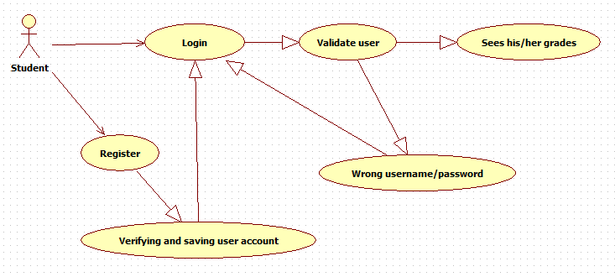
Students/pupils use case

Slide 5
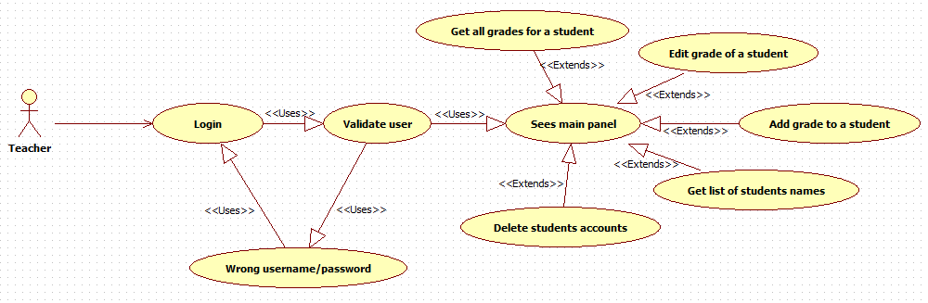
Teachers use case

Slide 6
Register:
Actors: Student(User).
Pre-conditions: Valid information.
Post-conditions: A new account has been created using the provided information.
Description: If the student choose to register a new account, the application will send him to a new page containing text fields for the username, password, phone email, first name and last name. In order to register a new profile the user must provide the requested data. Once the data is provided, the register button becomes available, allowing the user to click it. Once clicked the “Register” button, the application will validate data, and create a new account if everything is ok, redirecting the user to Login page.
Successful registration: If the information provided is valid, the new profile is saved in the database and the user can now login into the application.
Invalid first name/last name: If the names are not longer than 2 chars, an error message is displayed asking the user to correct the issue.
Invalid username: If the username is already in use, an message is displayed asking the user to choose a new username.
Invalid email: If the email is already in use or it is not a valid one, an error message is displayed asking the user to correct the issue.
Invalid password: If the password isn’t of a valid length or does not match the regEx “[A-Z][0-9a-zA-Z]{5,}”, an error message is displayed asking the user to correct the issue.
Empty fields: If any of the fields are empty, an error message will be displayed asking the user to correct the issue.

Slide 7
Login:
Actors: User.
Pre-conditions: The profile used must already exist in the database and the credentials must be valid.
Post-conditions: If valid credentials are provided, user can login.
Description: When the user opens the application, if there is no user logged in, the main window will ask him for username and password. After the user provides the required data, the appli-cation will verify if the credentials exists in database, and if they are correct the application will log in the user.
Successful login: If the username and the password provided by the user are correct, the application will open the roadmap view.
Wrong username/password combination: If the username or password were incorrect, an error message will be displayed to inform the user, and the text boxes will be cleared.
Empty fields: if the username or password fields are not completed, an error message will be displayed to inform the user.

Slide 8
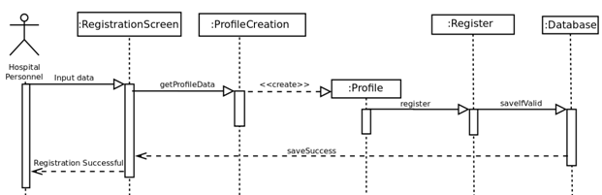
Use case: Registration Scenario: Register successful

Slide 9
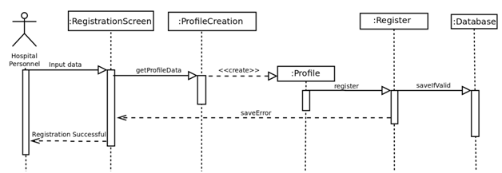
Use case: Registration Scenario: Register unsuccessful

Slide 10
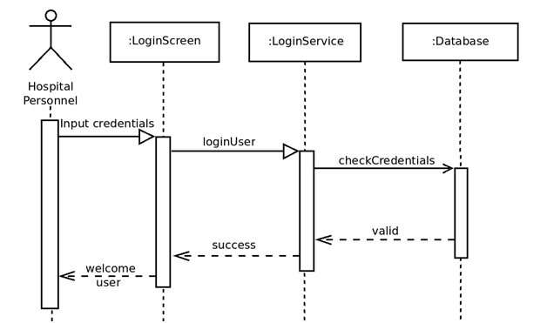
Use case: Authentification Scenario: Login successful

Slide 11
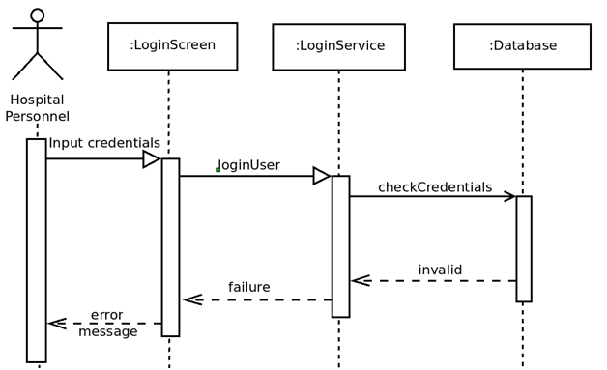
Use case: Authentification Scenario: Login unsuccessful

Slide 12
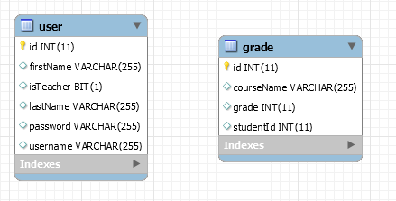
Database diagram

Slide 13
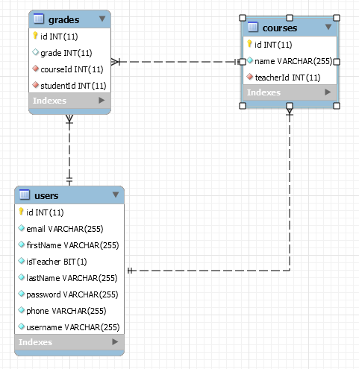
Database diagram(normalized)

Slide 14
Sql script
-- Dumping database structure for hibernate_db
CREATE DATABASE IF NOT EXISTS `studentscatalog` /*!40100 DEFAULT CHARACTER SET latin1 */;
USE `studentscatalog`;
-- Dumping structure for table studentscatalog.users
CREATE TABLE IF NOT EXISTS `users` (
`id` int(11) NOT NULL AUTO_INCREMENT,
`email` varchar(255) NOT NULL,
`firstName` varchar(255) NOT NULL,
`isTeacher` bit(1) NOT NULL,
`lastName` varchar(255) NOT NULL,
`password` varchar(255) NOT NULL,
`phone` varchar(255) NOT NULL,
`username` varchar(255) NOT NULL,
PRIMARY KEY (`id`),
UNIQUE KEY `UK_ncoa9bfasrql0x4nhmh1plxxy` (`email`),
UNIQUE KEY `UK_e8pwwyd4x0tdcvbeust6x0pyg` (`phone`),
UNIQUE KEY `UK_23y4gd49ajvbqgl3psjsvhff6` (`username`)
) ENGINE=InnoDB DEFAULT CHARSET=latin1;

Slide 15
Sql script(continuation)
-- Dumping structure for table studentscatalog.courses
CREATE TABLE IF NOT EXISTS `courses` (
`id` int(11) NOT NULL AUTO_INCREMENT,
`name` varchar(255) NOT NULL,
`teacherId` int(11) NOT NULL,
PRIMARY KEY (`id`),
UNIQUE KEY `UK_tloa6470p15f2vqulhosuuqeh` (`teacherId`),
CONSTRAINT `FK_tloa6470p15f2vqulhosuuqeh` FOREIGN KEY (`teacherId`) REFERENCES `users` (`id`)
) ENGINE=InnoDB DEFAULT CHARSET=latin1;
-- Dumping structure for table studentscatalog.grades
CREATE TABLE IF NOT EXISTS `grades` (
`id` int(11) NOT NULL AUTO_INCREMENT,
`grade` int(11) DEFAULT NULL,
`courseId` int(11) NOT NULL,
`studentId` int(11) NOT NULL,
PRIMARY KEY (`id`),
UNIQUE KEY `UK_4ylhry31gm70uof0lm9036ki9` (`courseId`),
UNIQUE KEY `UK_h7n4sxx5bf2kwfusfvgqofe4m` (`studentId`),
CONSTRAINT `FK_h7n4sxx5bf2kwfusfvgqofe4m` FOREIGN KEY (`studentId`) REFERENCES `users` (`id`),
CONSTRAINT `FK_4ylhry31gm70uof0lm9036ki9` FOREIGN KEY (`courseId`) REFERENCES `courses` (`id`)
) ENGINE=InnoDB DEFAULT CHARSET=latin1;

Slide 16
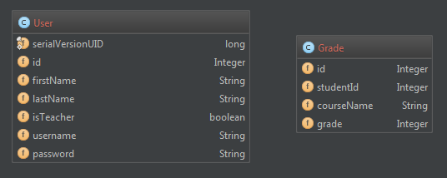
ro.fortech.bean

Slide 17
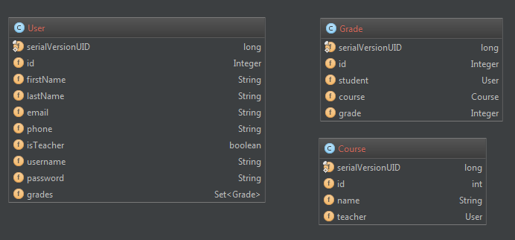
ro.fortech.bean

Slide 18
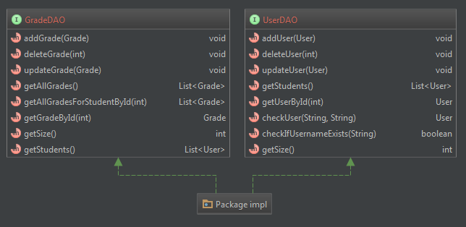
ro.fortech.DAO

Slide 19
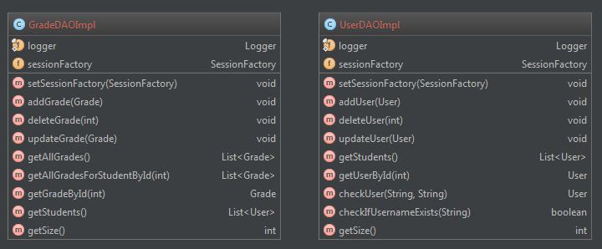
ro.fortech.DAO.impl

Slide 20
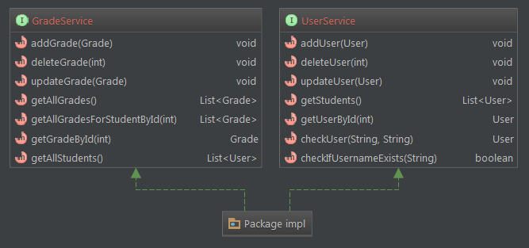
ro.fortech.service

Slide 21
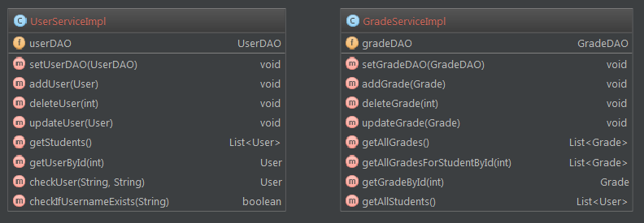
ro.fortech.service.impl

Slide 22
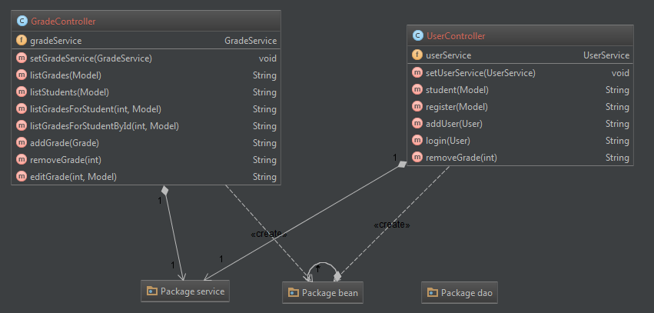
ro.fortech(controllers)

Slide 23
